Slide 1
UNIT I – BASICS OF SDN
UNIT I – SESSION 1
SESSION 3
Genesis of SDN
The Evolution of Networking Technology
Forerunners of SDN
Reference: Ref. 1, Ch. 3.1, 3.2

Slide 2
The Evolution of Networking Technology

Slide 3
The Evolution of Networking Technology
Earliest days of computing
There was no networking;
Each individual computer occupied an entire room or even an entire floor
mainframes emerged
Computing powerhouses still operated as islands,
Any data sharing took place using physical media such as magnetic tapes/ CD.
Evolution
Mainframe Networking: Remote Terminals
Peer-to-Peer, Point-to-Point Connections
Local Area Networks
Bridged Networks
Routed Networks

Slide 4
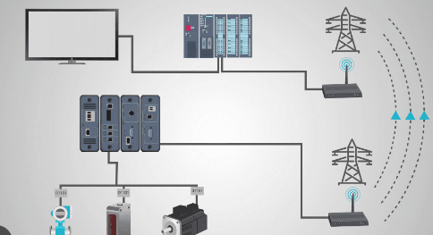
1. Mainframe Networking: Remote Terminals
Remote terminals are devices used to access a central computing system, such as a mainframe or server, from a remote location. These terminals provide users with the ability to interact with applications and data hosted on the central system without requiring local processing power or storage.
Remote terminals are commonly used in various computing environments, including mainframe systems, Unix/Linux servers, and cloud-based services.
Remote connectivity to the mainframe was provided in the form of remote terminal controllers and card readers, which operated as subservient devices known as peripherals, with control residing entirely in the central mainframe.
Communication was solely between a few connected entities, in this case the mainframe and a small set of remote terminal controllers or card readers.

Slide 5
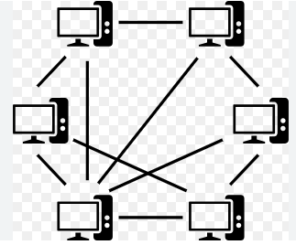
2. Peer-to-Peer, Point-to-Point Connections
Computer technology - Mainframes to the addition of minicomputers
Greater need to share information in a quick and efficient manner.
Computer manufacturers began to create protocols for sharing data between two peer machines.
The network in this case was also point-to-point
The nature of the connection was peer-to-peer

Slide 6
3. Local Area Networks
Local area networking (LAN) technology arrived, with various battles being fought between technologies (e.g., Ethernet/IEEE 802.3 versus Token Ring/IEEE802.5).
Early LANs were running on shared media, so all traffic was seen by every device attached to the network.
IEEE 802.3 - more popular; uses CSMA/CD technology; exhibits poor aggregate throughput when the number of active devices reaches a certain level; Network becomes very inefficient.
Repeater devices provided physical extensions to the shared media by merely forwarding all frames to the extended medium - required minimum control plane intelligence, if any.

Slide 7
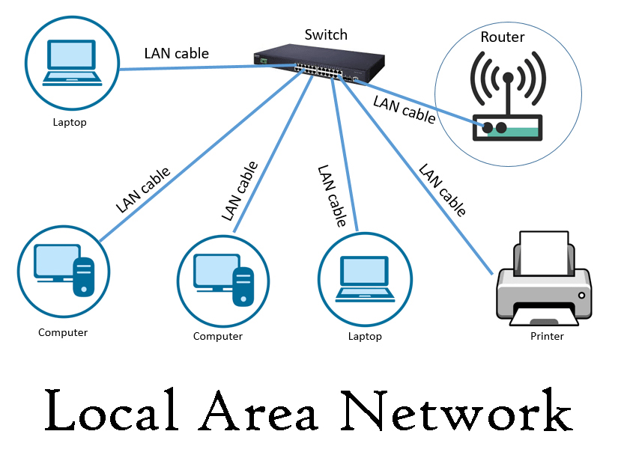
Simple repeaters just forwarded to everybody.
More advanced, managed repeaters have limited control planes where segmentation and error monitoring occurred. - Functions like removing erroneous traffic from the network, as well as removing isolated ports that were causing problems.
Segmentable repeaters were able to split themselves into multiple repeaters via configuration.
Different groups of ports could be configured to reside in different collision domains. These separate collision domains would be connected by bridges.

Slide 8
4. Bridged Networks
Shared-media networks do not scale well as the number of hosts grows.
Desirable to split the shared-media network into separate segments.
Since not all the nodes are transmitting all the time, spatial reuse occurs and the aggregate available bandwith actually increases due to the locality of transmissions in each segment.
The first devices to perform this functionality were called bridges, forerunners of today’s switches but much simpler.
Had only two ports connecting two shared domains; possessed an incipient control plane in that they were able to actually learn the location and MAC address of all devices and create forwarding tables that allowed them to make decisions about what to do with incoming packets.

Slide 9
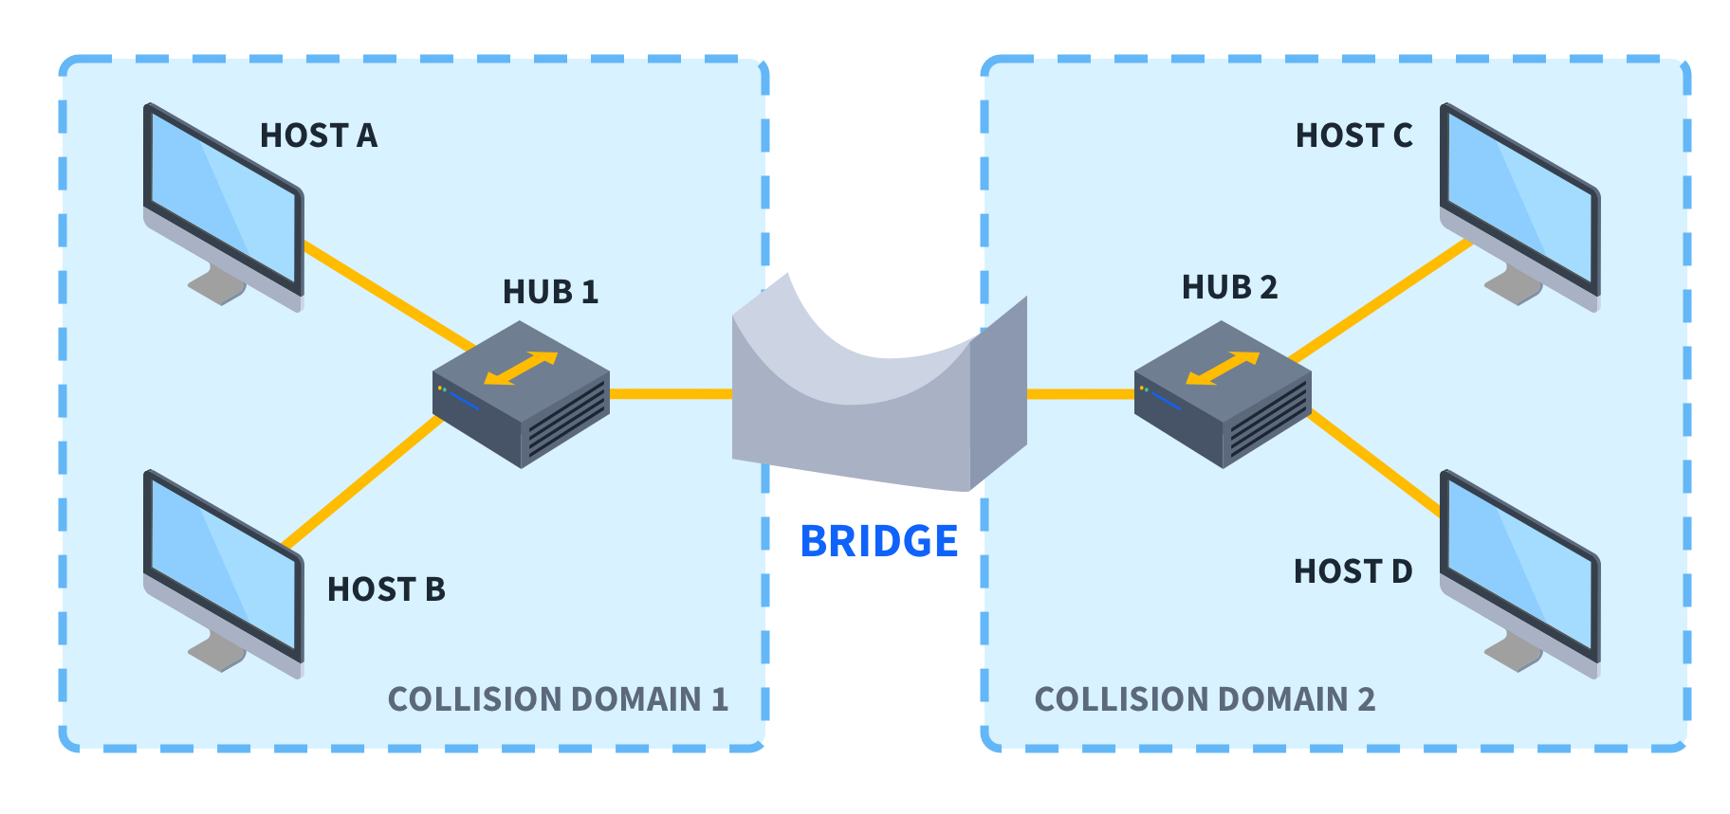
Each device was able to operate independently and autonomously, without requiring any centralized intelligence.
The goal was to facilitate expansion of the network without a lot of coordination or interruption across all the devices in the network.
The important point here is that this greater scale in terms of the number of nodes as well as physical extent drove the need for this new model of individually autonomous devices, with distributed protocols implementing the required control functionality.

Slide 10
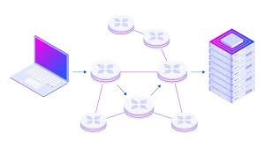
5. Routed Networks
A routed network is a type of computer network where data is transmitted between network segments (subnets) using routers
Routers were directly connected locally to layer two domains and interconnected over large distances with point-to-point WAN links.
Distributed routing protocols were developed to allow groups of interconnected routers to share information about those networks to which they were directly connected.
By sharing this information among all the routers, each was able to construct a routing table,

Slide 11
5. Routed Networks
During this evolution, however, the growth of network size and complexity was unrelenting.
The size of MAC forwarding tables grew, control plane protocols became more complex, and network overlays and tunneling technology became more prevalent.
Since the devices were designed to operate independently, centrally administered, large-scale upgrades were challenging.
Existing solutions were not scaling well with this growth and complexity.
This situation led network engineers and researchers to question whether this evolution was headed in the right direction.

Slide 12
The Forerunners of SDN

Slide 13
Forerunners of SDN
Prior to OpenFlow, and certainly prior to the birth of the term Software Defined Networking, forward_x0002_thinking researchers and technologists were considering fundamental changes to today’s world of autonomous, independent devices and distributed networking intelligence and control.
There is a steady progression of ideas around advancing networking technology toward what we now know as SDN.
There are many approaches that lead to the development of today’s Software Defined Networks(SDN). They are:

Slide 14
1. Early efforts
Some of the earliest work in programmable networks began not with Internet routers and switches but with ATM switches.
Two notable examples were Devolved Control of ATM Networks (DCAN) and open signaling.
DCAN prescribed the separation of the control and management of the ATM switches from the switches themselves.
This control would be assumed by an external device that is similar to the role of the controller in SDN networks.
Open signaling proposed a set of open, programmable interfaces to the ATM switching hardware.
The key concept was to separate the control software from the switching hardware.
General Switch Management Protocol (GSMP)
In GSMP, a centralized controller is able to establish and release connections on an ATM switch.

Slide 15
2. Network Access Control
Network access control (NAC) products control access to a network based on policies established by the network administration.
The most basic control is to determine whether or not to admit the user onto the network.
This decision is usually accomplished by some exchange of credentials between the user and the network.
If the user is admitted, his rights of access will also be determined and restricted in accordance with those policies.
In some early efforts, network policy beyond admission control was dynamically provisioned via NAC methods, such as Remote Authentication Dial-In User Service (RADIUS) and Common Open Policy Service (COPS) .

Slide 16
RADIUS
To provide the automatic reconfiguration of the network.
RADIUS can be viewed as a precursor to SDN.
Networking attributes would change based on the identity of the compute resource that had just appeared and required connectivity to the network.
Originally designed for the authentication, authorization, and accounting (AAA) processes related to granting a user access to a network.
Solutions of this nature achieved automatic reconfiguration of the network but never gained the full trust of IT administrators and, thus, never became mainstream.
The static, manually configured core of the network remained the same. This problem still awaited a solution.

Slide 17
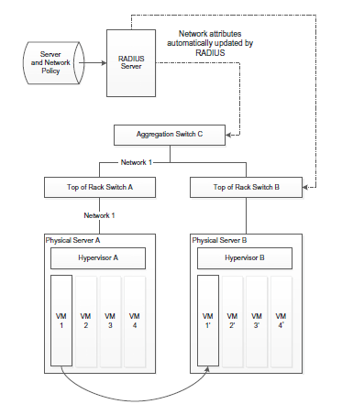

Slide 18
RADIUS
RADIUS-based solution for automating the process of creating network connectivity for a virtual server.
In the figure, the process would be that a VM is moved from physical server A to physical server B, and as a result the RADIUS server becomes aware of the presence of this VM at a new location.
The RADIUS server is then able to automatically configure the network based on this information, using standard RADIUS mechanisms

Slide 19
3. Orchestration
orchestration is the automated configuration, coordination, and management of computer systems and software. This can mean various things depending upon what it is applied to.
When used in the context of network orchestration which has to do with the setting up of devices, applications, and services in the network to achieve particular network objectives. The orchestrator is a single entity on the network from which the whole network infrastructure can be configured and managed as a single entity.
These orchestration applications would typically utilize common device application programmer interfaces (APIs) such as the Command-Line Interface (CLI) or Simple Network Management Protocol (SNMP).
Figure shows Layout and operation of an orchestration management solution for automating the process of creating network connectivity for a virtual server SNMP/CLI

Slide 20
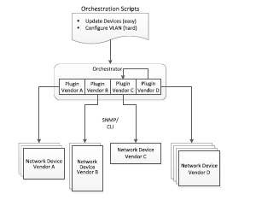
An orchestration solution can then have certain higher-level policies that are in turn executed at lower levels by the appropriate plugins.
The vendor-specific plugins are used to convert the higher-level policy requests into the corresponding native SNMP or CLI request specific to each vendor.
Such orchestration solutions alleviated the task of updating device configurations.
Consequently, orchestration management applications continued to be useful primarily for tasks such as software and firmware updates but not for tasks that would be necessary in order to automate today’s data centers
https://www.youtube.com/watch?v=J3sh3IeLFh0

Slide 21
4. Virtualization Manager Network Plugins
The concept of virtualization manager network plugins builds on the notion of orchestration and attempts to automate the network updates that are required in a virtualization environment.
The plugins would then take the appropriate actions on the networking devices they controlled in order to make the network follow the server and storage changes with changes of its own.
Generally, the mechanism for making changes to the network devices would be SNMP or CLI commands.
These plugins can be made to work, but since they must use the static configuration capabilities of SNMP and CLI, they suffer from being difficult to manage and prone to error

Slide 22
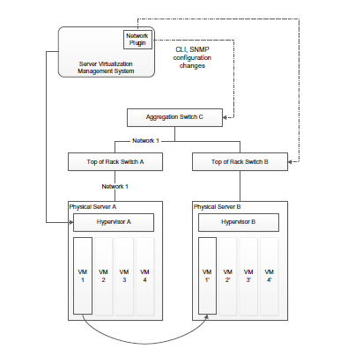
The most notable difference is that this application starts from a base that supports virtualization.
The nature of the reconfiguration managed by this application is oriented to support the networking of virtual machines via VLANs and tunnels
Layout and operation of a virtualization manager plugin solution for automating the process of creating network connectivity for a virtual server

Slide 23
5. ForCES: Separation of Forwarding and Control Planes
The Forwarding and Control Element Separation (ForCES) work produced in the IETF began around 2003.
ForCES was one of the original proposals recommending the decoupling of forwarding and control planes.
The idea of separation of data plane(forwarding element) and control plane was first proposed by FORCES. It is said that hardware-based forwarding entities are controlled by a software-based control plane.
These simple hardware forwarders were constructed using cell-switching or tag-switching technology.
The software based control had responsibility for the broader tasks, often involving coordination between multiple network devices (e.g., BGP routing updates).

Slide 24
Functional components of ForCES
• Forwarding Element - implemented in hardware and located in the network; Responsible for enforcement of the forwarding and filtering rules that it receives from the controller.
• Control Element - concerned with the coordination between the individual devices in the network and for communication forwarding and routing information to the FEs below.
Network Element - actual network device that consists of one or more FEs and one or more CEs.
ForCES protocol - To communicate information back and forth between FEs and Ces.

Slide 25
ForCES proposes the separation of the forwarding plane from the control plane, and it suggests two different embodiments of this architecture.
In one of these embodiments, both the forwarding and control elements are located within the networking device.
The other embodiment speculates that it would be possible to actually move the control element(s) off the device and to locate them on an entirely different system.
Although the suggestion of a separate controller thus exists in ForCES, the emphasis is on the communication between CE and FE over a switch backplane, as shown in Figure.

Slide 26
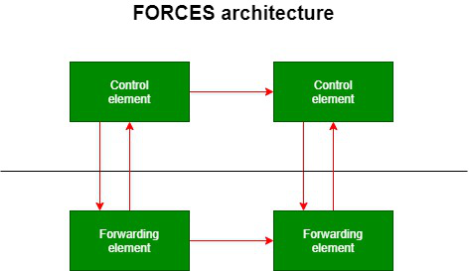

Slide 27
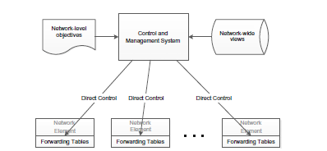
6. 4D: Centralized Network Control
4D, named after the architecture’s four planes—decision, dissemination, discovery, and data—proposes a complete refactoring of networking away from autonomous devices and toward the idea of concentrating control plane operation in a separate and independent system dedicated to that purpose.

Slide 28
4D centers around three design principles:
Network-level objectives. The objectives should be stated in terms of the whole network instead of individual devices.
Network-wide view. There should be a comprehensive understanding of the whole network. Topology, traffic, and events from the entire system should form the basis on which decisions are made and actions are taken.
Direct control. The control plane elements should directly be able to control the data plane elements. It should have the ability to program the forwarding table on individual devices..

Slide 29
7. Ethane: Controller-Based Network Policy
Ethane specifies network-level access of users which is defined by network administrators. Ethane is the exact forerunner of Software Defined Networks(SDN)Ethane is built around three fundamental principles:
The network should be governed by high-level policies.
Routing should follow High-level policies.
There should be a connection between packets and their origin in the network.

Slide 30
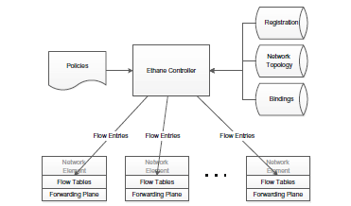

Slide 31
To test Ethane, the researchers themselves had to develop switches, a device that allows control plane functionality to be determined by an external entity (the controller) and that communicates with that external entity via a protocol that allows flow entries to be configured into its local flow tables, which then perform the forwarding functions as packets arrive.
The behavior of the Ethane switches is generally the same as today’s OpenFlow switches, which forward and filter packets based on the flow tables that have been configured on the device.
If the switch does not know what to do with the packet, it forwards it to the controller and awaits further instructions.
Ethane is basically a Software Defined Networking technology, and its components are the antecedents of OpenFlow.

